Slide 1

Enhancing Accessibility on Social Media Platforms in Federal Agencies
November 2024

Slide 2

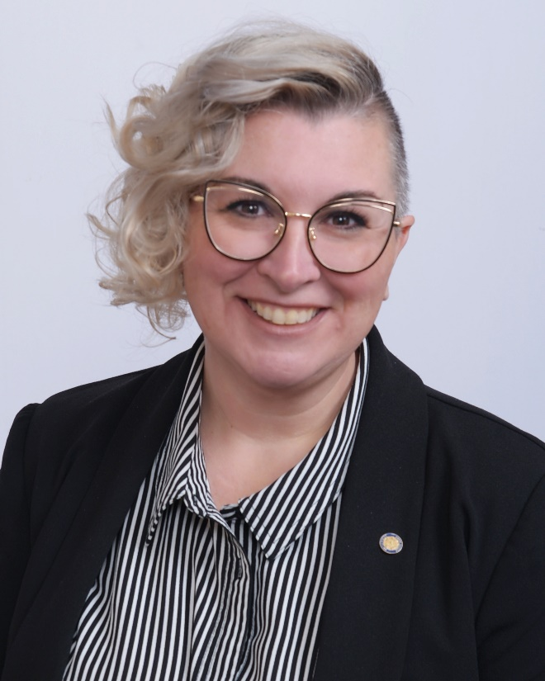
Presenters (1)
David O'Keefe
Events and Communication Specialist
U.S. Access Board
Amy Nieves
Public Affairs Specialist
U.S. Access Board

Slide 3
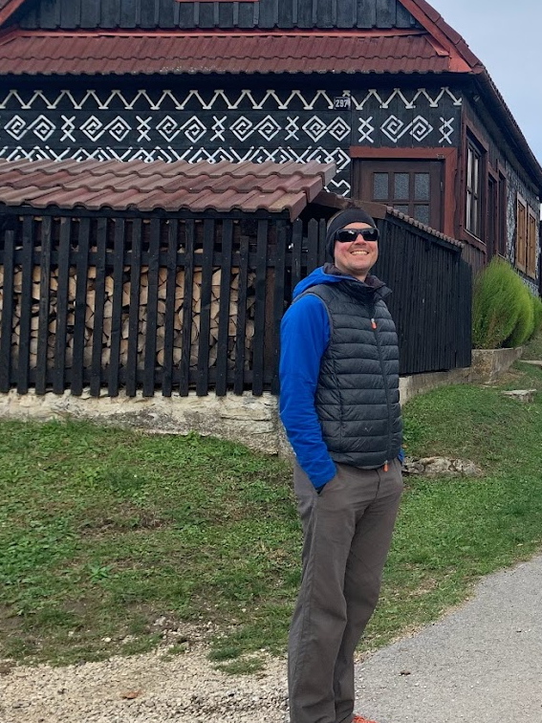
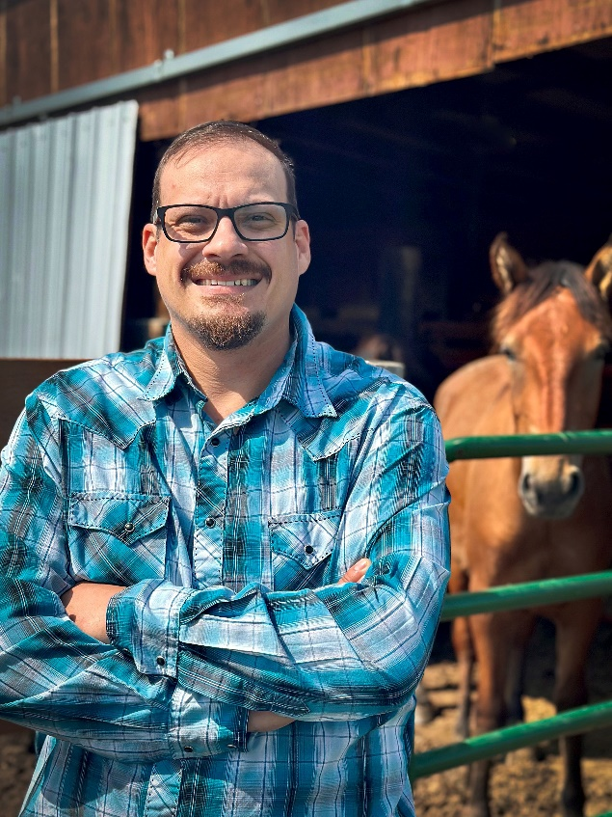
Presenters (2)
Alex Lindeman
IT Specialist, Section 508 Program Coordinator
National Park Service (NPS)
Bryson Jones
National Social Media Manager
U.S. Fish and Wildlife Service (USFWS)

Slide 4
Agenda
Introduction to U.S. Access Board
Introduction to NPS and USFWS
Social Media Engagement Strategies
Social Media Resources
Questions and Answers (time permitting)

Slide 5
Introduction to U.S. Access Board

Slide 6

What Does the Access Board Do?
Develops minimum accessibility guidelines and standards
Provides technical assistance and training on these guidelines and standards:
ADA and Architectural Barriers Act (ABA) design standards
Public Right-of-Way Accessibility Guidelines (PROWAG)
Medical Diagnostic Equipment (MDE)
Transportation vehicle guidelines
Section 508 of the Rehabilitation Act
Passenger Vessels Accessibility Guidelines (PVAG)
Enforces the ABA Standards

Slide 7
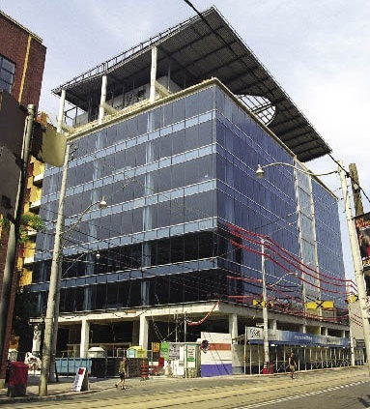
What Does the Access Board Not Do?
Does not enforce standards other than the Architectural Barriers Act (ABA)
Provides guidance on ADA Accessibility Standards but does not provide guidance on ADA regulations such as:
Equivalent facilitation
Program access
Readily achievable barrier removal
Operational issues
Does not provide interpretation of other building codes (IBC/ICC, state, or local building codes)

Slide 8
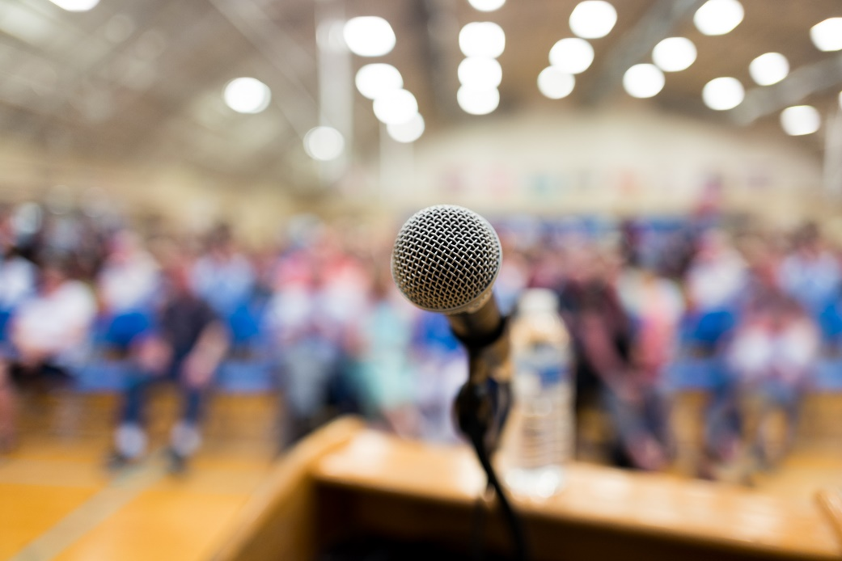
Public Affairs and Communication
Public Affairs
Communication
Partnership for Information Equity
Federal, State, and Local Partnerships
Public Engagements

Slide 9
Introduction to National Park Service & U.S. Fish and Wildlife Service

Slide 10

National Park Service
Since 1916, the National Park Service has been entrusted with the care of our national parks. With the help of volunteers and partners, we safeguard these special places and share their stories with more than 318 million visitors every year. But our work doesn't stop there.
We are proud that tribes, local governments, nonprofit organizations, businesses, and individual citizens ask for our help in revitalizing their communities, preserving local history, celebrating local heritage, and creating close-to-home opportunities for kids and families to get outside, be active, and have fun.

Slide 11

U.S. Fish & Wildlife Service
The U.S. Fish & Wildlife Service is the only agency in the federal government whose primary responsibility is the conservation and management of fish, wildlife, plants and their habitats for the American people.
We offer a variety of opportunities to enjoy the outdoors and our shared natural heritage. And through our work to conserve natural resources, we provide communities with healthier environments, clean water, flood control and a strong economy.

Slide 12
Social Media Engagement Strategies

Slide 13
Terminology

Slide 14
Alt Text (1)
Alt text (short for alternative text) is text that is embedded into images or GIFs that conveys the meaning of the image
Alt text is designed to make visual content accessible to people who are using screen readers
In general, alt text should be concise, communicate relevant content provided by the image, and not repeat any information provided in the text of the post

Slide 15
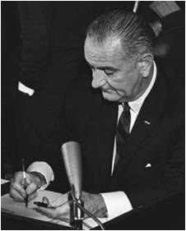
Alt Text (2)
Example of alt text for photos:
Helpful: “President Lyndon B. Johnson signs a bill.”
Unhelpful: “Black and white photo of President Lyndon B. Johnson wearing a suit and tie. He is signing a bill while holding two different pens.”

Slide 16

Alt Text (3)
Example of alt text for logos:
Helpful: “GSA logo with text: Section508.gov Buy. Build. Be Accessible.”
Unhelpful: “Logo”

Slide 17
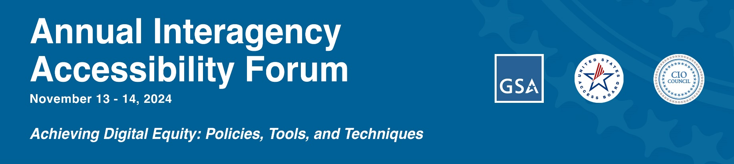
Alt Text (4)
Example of alt text for images with text:
Helpful: “Annual Interagency Accessibility Forum. November 13-14, 2024. Achieving Digital Equity: Policies, Tools, and Techniques. Logo and Seals for GSA, U.S. Access Board, and the CIO Council.”
Unhelpful: “Event details with tagline and logos.”

Slide 18
Color Contrast (1)
Color contrast is the difference between the color of text and the color of the background behind it
Certain color contrast ratios can result in the text of a graphic or image being difficult to read
Excluding logos or brand names, it is best to maintain a contrast ratio of 4.5:1 for regular text and 3:1 for large text
This ratio is the minimum required for federal content creators
Use a color contrast analyzer to determine the ratio of your graphic
There are various free versions of this tool available online

Slide 19
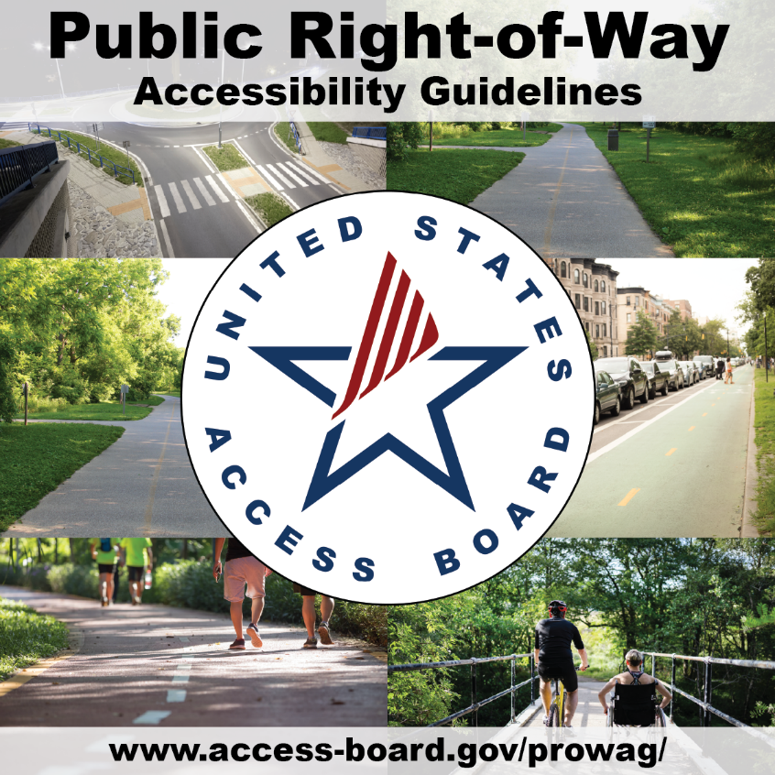
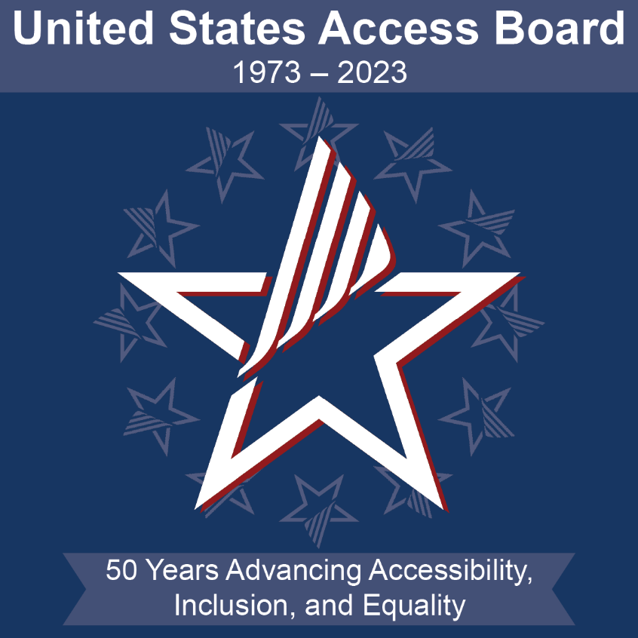
Color Contrast (2)
Examples of graphics with accessible color contrast:

Slide 20
Emojis (1)
Too many emojis in one post can be confusing or annoying for users using screen readers, as these programs will individually describe each emoji, which can take up a lot of time
Using several emojis in a row can cause the same problems
Therefore, it is best to limit your overall use of emojis and to avoid using several emojis in a row

Slide 21
Emojis (2)
Example of accessible emoji use:
The Access Board is proud to announce that in Fiscal Year 2024, we resolved 85 Architectural Barriers Act (#ABA) complaints through corrective action. 🧰 Click here to learn more about this important work of the agency to ensure federal #accessibility: https://access-board.gov/news/2024/10/18/u-s-access-board-resolves-85-architectural-barriers-act-complaints-through-corrective-action-in-fiscal-year-2024/

Slide 22
GIFs
GIFs are popular on social media for reactions without words, usually as continuously looping animations
As these animations don’t have user controls to pause, stop, or hide the animation, and may include harmful flashing or blinking, it is not recommended to use GIFs unless they can be made fully accessible
Some social media sites may incorporate these controls, but this must be considered on a platform-by-platform basis
If you do use GIFs, and they contain text, then ensure that they have an accessible color contrast
Always include alt text for GIFs

Slide 23
Hashtags
Screen readers may see a multi-word hashtag as being one word, and they will read it as such
Therefore, always capitalize each word in a multi-word hashtag
If possible, do the same with your account handles
Examples:
#FourthOfJuly
#VeteransDay
@AccessBoard
@CommerceGov

Slide 24
Plain Language (1)
Plain language is writing that is designed to be understood as quickly and clearly as possible
It is best to use plain language when creating public-facing content for social media
Important elements of plain language include:
Use of active voice
Short sentences
Step-by-step instructions
Avoidance of complicated terminology or jargon

Slide 25
Plain Language (2)
Example from PlainLanguage.gov:
Poorly written text:
The Open Door Initiative is a program based on a simple and fresh attitude: that the CMS desires to better hear and interact with those beneficiaries, providers, and other stakeholders interested in the delivery of quality healthcare for our nation’s seniors and beneficiaries with disabilities. This increased emphasis on responsiveness is captured through an ongoing series of ‘Open Door Forums’ that provide a dialogue about both the many individual service areas and beneficiary needs within CMS.

Slide 26
Plain Language (3)
Example from PlainLanguage.gov:
Well written text:
We want to hear from you! Help us improve our service to you. Attend an Open Door forum near you. For information about upcoming forums, visit cms.gov.

Slide 27


Special Characters
Special characters are letters or symbols that don’t appear on the QWERTY keyboard
Screen readers may struggle to properly identify special characters, so it is best to avoid using them in social media posts
Examples:
Section sign
“Ash” or “ash tree” letter

Slide 28
Platform-Specific Strategies

Slide 29
X/Twitter (1)
Text: It is especially important to employ plain language on X, since there is currently a 280-character limit for free accounts
Tag any agencies or organizations that you reference (as opposed to spelling out the full name), as this saves character space and links users to the respective agency if they want to learn more
GIFs: X has an in-house feature for adding GIFs to posts (via GIPHY); if you utilize this feature, then ensure that you include alt text
If your GIF contains text, then ensure that its color contrast ratio is accessible

Slide 30
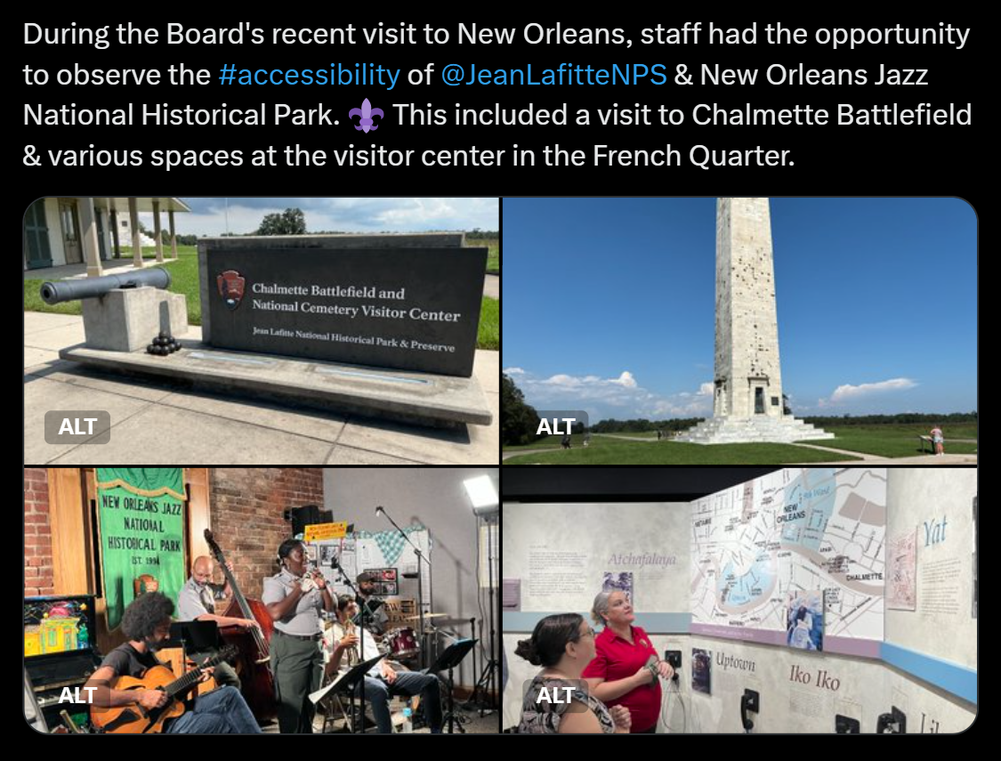
X/Twitter (2)
Example of an accessible X post:

Slide 31
LinkedIn (1)
GIFs: If you have your own GIF file, then you can add it to your post as if it were an image or video
You should still insert alt text, and if your GIF contains text, then ensure that its color contrast ratio is accessible
Documents: LinkedIn allows users to upload documents to their posts, but this can cause accessibility issues, as users can download your file as a PDF
It is best to avoid this feature and instead link back to an accessible webpage with the relevant information
Events: When creating events on LinkedIn, follow the previous guidance and remember to add alt text to your cover image for the event

Slide 32
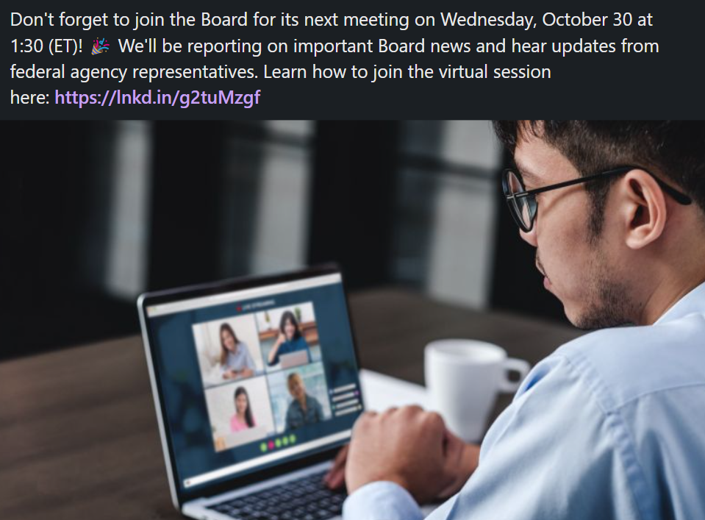
LinkedIn (2)
Example of an accessible LinkedIn post:

Slide 33
Facebook (1)
Images: Never use the automatically generated alt text for images
GIFs: If you use Facebook’s GIF feature, then ensure that you include alt text in the body of the post itself, as you cannot currently add alt text to GIFs
If your GIF contains text, then ensure that its color contrast ratio is accessible
Events: Facebook does not currently allow users to add alt text to the cover image for events; therefore, do not include any information in the cover image that is not included elsewhere in the title or description
Additionally, avoid using GIFs as cover images for events

Slide 34
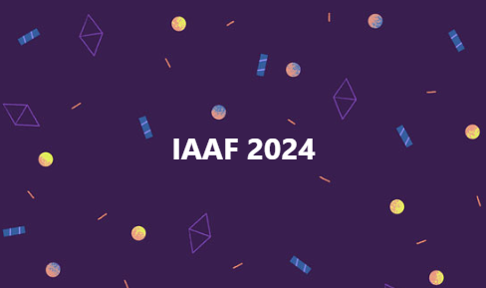
Facebook (2)
Facebook allows users to customize the background color and design of posts
If you use this feature, then ensure that there is still an accessible contrast between the text and background colors
Ensure color contrast accessibility at all points where text overlays the background – if there is doubt as to whether a more complicated background design is accessible, it is best to avoid it

Slide 35
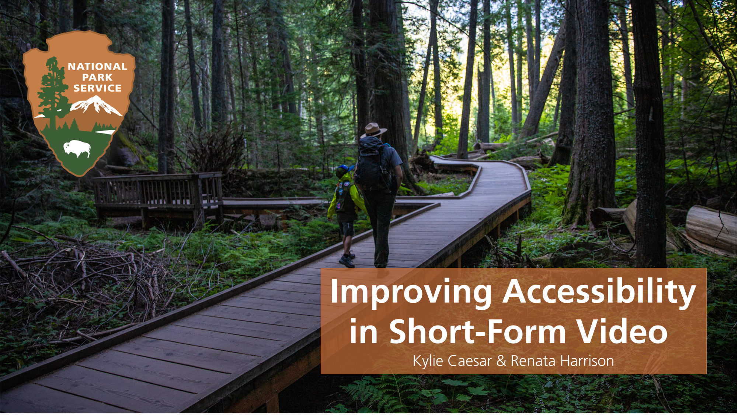
NPS and Insta Reels
Instagram, pro & con:
Instagram supports alt text, so that's great.
Short form videos (Reels) are a larger challenge.

Slide 36
NPS and Reels: Why?
"Reels are like an inside joke, you can't really tell what's going on until you see it yourself!"
Anonymous NPS employee
"All audiences should be able to experience our content. A written text description of video content is only acceptable if that video has no sound, like a GIF. Audio description is necessary so a person that is blind or low vision can understand what is being shown.”
Matt Turner (NPS national social media lead)

Slide 37
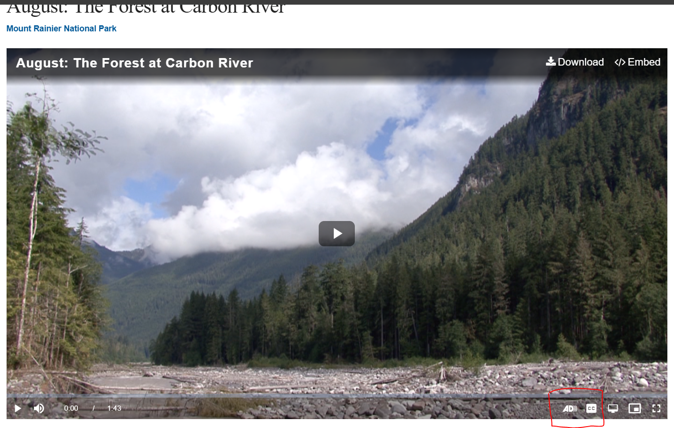
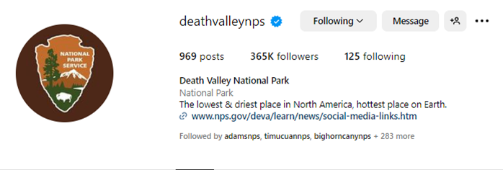
NPS and Reels: How
In NPS, we recommend two methods:
Plan ahead to build description into main audio
Make an audio-described version, upload to NPS.gov, link in bio

Slide 38
NPS and Reels: Examples
Watch & listen for yourself:
Crown of the Continent Research Learning Center
Glacier National Park
Zion National Park

Slide 39

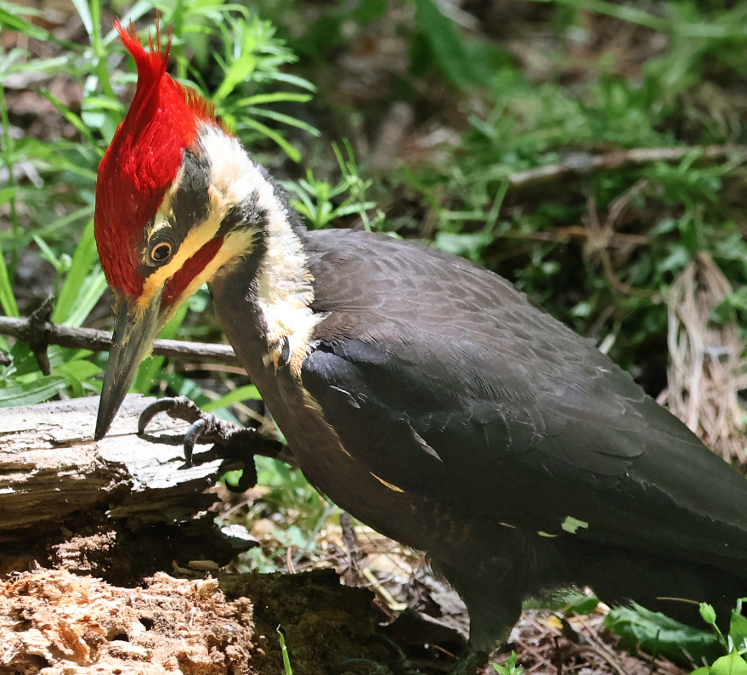
USFWS on Instagram (1)
Why is accessibility so crucial in Social Media?
70% or America is on social media
6.2 percent of U.S. adults are deaf or have serious difficulty hearing
5.5 percent of U.S. adults have a vision disability with blindness or serious difficulty seeing even when wearing glasses
Future Considerations:
AI tools are making editing, audio descriptions, and transcripts seamless
More and more video players have built in accessibility

Slide 40
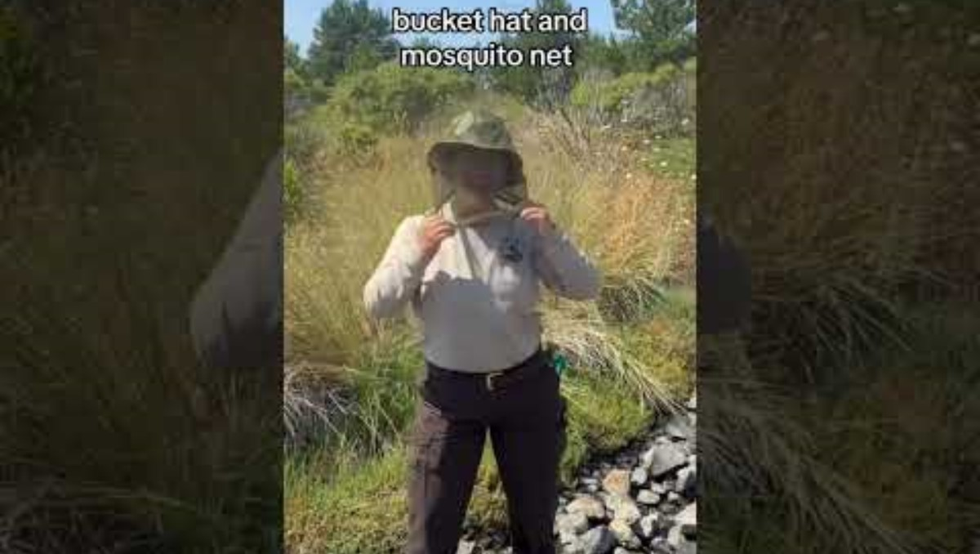
USFWS on Instagram (2)
USFWS uses alt-text on all still pieces of content on Instagram
For Reels and videos we provide a link to our Audio Described version in our bio
We typically also include a video description in the caption as an extra resource
Planning required to create AD version & ensure partners are compliant
Mixture of contracted AD and/or creator made

Slide 41
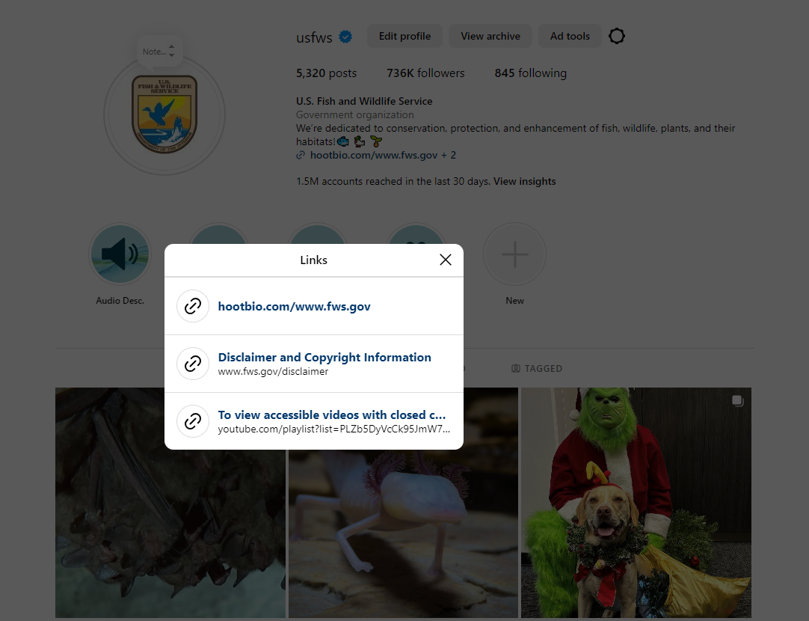
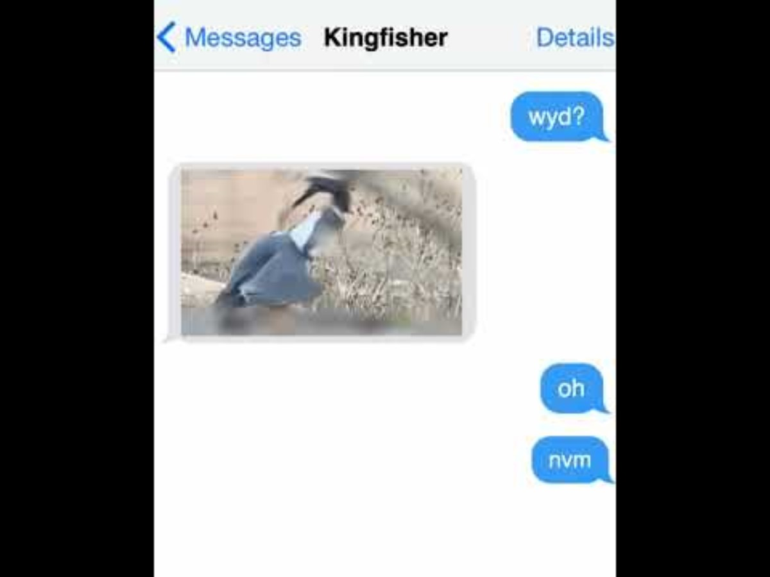
USFWS on Instagram (3)

Slide 42
Social Media Resources

Slide 43

Access Board Social Media
View examples of accessible social media posts on:
X (formerly Twitter): @AccessBoard
LinkedIn: @us-access-board
Facebook: @usAccessBoard
YouTube: U.S. Access Board

Slide 44
NPS Social Media
View examples of accessible social media posts on:
Facebook: @NationalParkService
Instagram: @NationalParkService
X (formerly Twitter): @NatlParkService
Flickr: @NationalParkService
LinkedIn: @National-Park-Service
YouTube: @NationalParkService
A listing of all park and program accounts can be found on the US Digital Registry

Slide 45
USFWS Social Media
View examples of accessible social media posts on:
Facebook: @USFWS
Instagram: @USFWS
Twitter: @USFWS
LinkedIn: @USFWS
Pinterest: @USFWS
Flickr: @USFWSHQ
YouTube: @USFWS

Slide 46
Platform-Specific Resources
X (formerly Twitter)
LinkedIn
Facebook
YouTube (adding subtitles and captions)
Instagram
Snapchat
Tumblr
Flickr

Slide 47
Additional Resources
Section508.gov provides guidance on accessible social media creation
PlainLanguage.gov contains many guides, examples, and trainings on plain language composition
Digital.gov houses various resources, articles, and blog posts on digital accessibility topics
The U.S. Access Board holds bi-monthly webinars on topics pertaining to the accessibility of information and communication technology (ICT)

Slide 48
Questions and Answers

Slide 49
Thank You

